Slide 1
North Hennepin Community College MS4 Plan
October 24, 2014

Slide 2
Background
First, what does MS4 stand for?
Small Municipal Separate Storm Sewer Systems (MS4)
Why is North Hennepin Community College an MS4?
MnSCU campuses located in an urban area were designated by the Minnesota Pollution Control Agency as an MS4 in 2006
What is the goal of an MS4 Plan?
To maintain and improve “waters of the state” through treatment of urban storm water runoff.

Slide 3
What is required by an MS4 Plan?
Implement six minimum control measures (MCMs)
Public education and outreach
Public participation and involvement
Illicit discharge detection and elimination
Construction site runoff control
Post construction site runoff control
Pollution prevention/good housekeeping

Slide 4
MCM I – Public Education and Outreach
Distribute education materials
Public participation
Education program
Annual public meeting

Slide 5
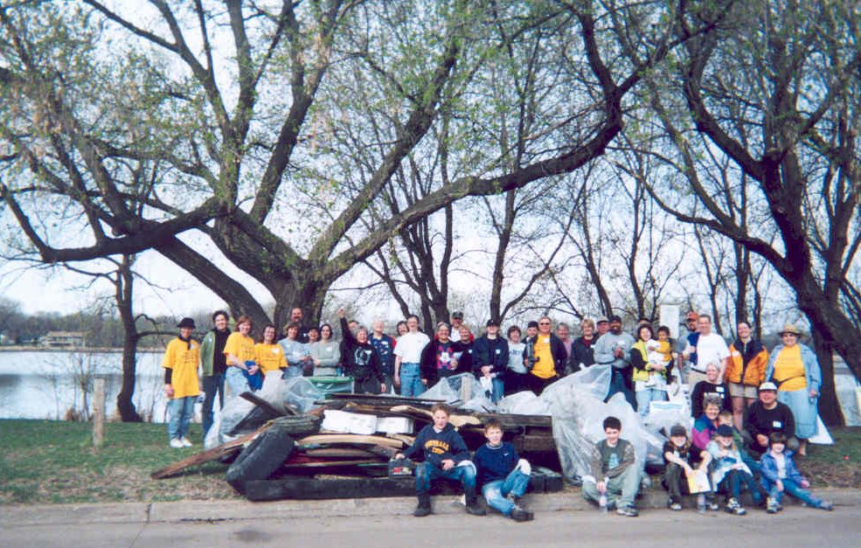
MCM II – Public Participation/ Involvement
Public notice of annual meeting
Solicit public input
Consider public input
Annual campus clean-up event

Slide 6
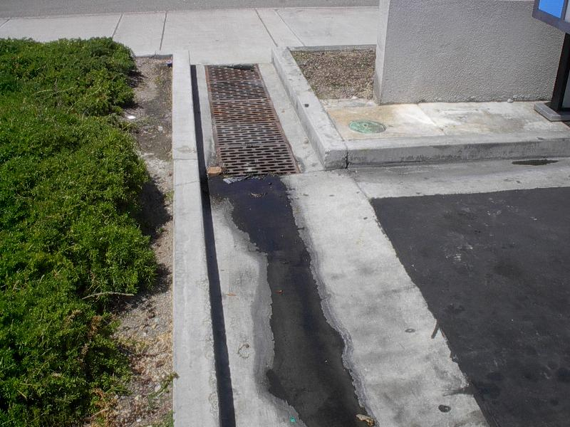
MCM III – Illicit Discharge Detection and Elimination
Storm sewer map
Regulatory control program
Detection plan
Public and employee information program

Slide 7
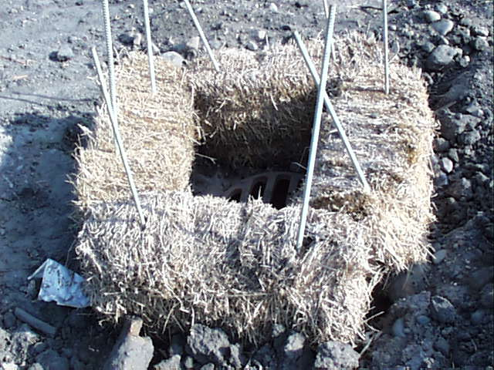
MCM IV – Construction Site Storm water run-off control
Construction site erosion and sediment control BMPs
Waste control BMPs
Site plan reviews
Procedure for complaints of storm water non-compliance
Site inspection and enforcement

Slide 8
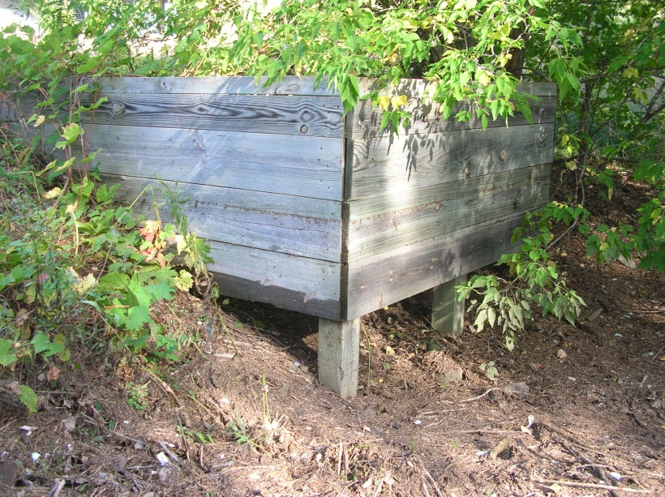
MCM V – Post Construction Site Run-off Control
Development of structural and non-structural storm water BMPs
Regulatory mechanisms for compliance
Long-term O & M of BMPs

Slide 9
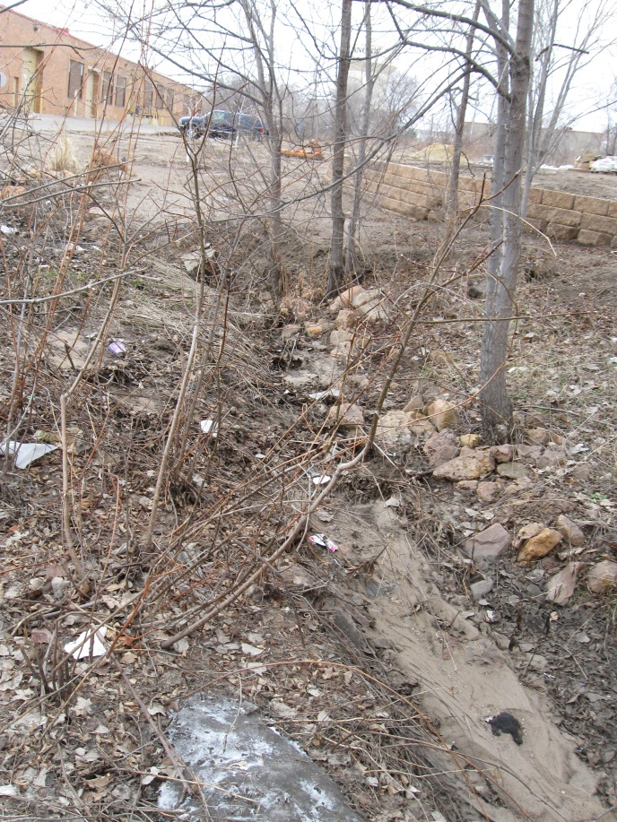
MCM VI – Pollution Prevention/Good Housekeeping
Maintenance program
Street sweeping
Annual inspections
Record keeping
Impaired waters review
Annual report

Slide 10
Questions?
Please Contact:
Tim Morrell
NHCC Safety and Health Officer
763-488-03-132

